Slide 1
Computer Engineering Program Qualifying Exam
Jingyun Ning
(jn2ne)

Slide 2
CpE Qualifying Exam
Primary paper
Autoware on Board: Enabling Autonomous Vehicles with Embedded Systems
Shinpei Kato, Shota Tokunaga, Yuya Maruyama, Seiya Maeda, Manato Hirabayashi, Yuki Kitsukawa, Abraham Monrroy, Tomohito Ando, Yusuke Fujii, and Takuya Azumi
2018 9th ACM/IEEE International Conference on Cyber-Physical Systems
Reviewed and presented by Jingyun Ning (jn2ne@virginia.edu)

Slide 3
Outline
Introduction
Architectures of Self-driving cars
Problem Statement
Autoware System Models
Sensing Model
Computing Model
Actuation Model
Evaluation
Conclusion
1

Slide 4
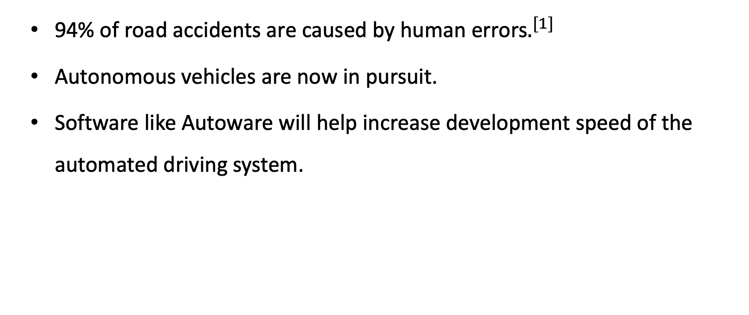
Autonomous Driving
94% of road accidents are caused by human errors$.^{[1]}$
Autonomous vehicles are now in pursuit.
Software like Autoware will help increase development speed of the automated driving system.
2
[1] S. Singh, “Critical reasons for crashes investigated in the national motor vehicle crash causation survey,” Tech. Rep., 2015.

Slide 5
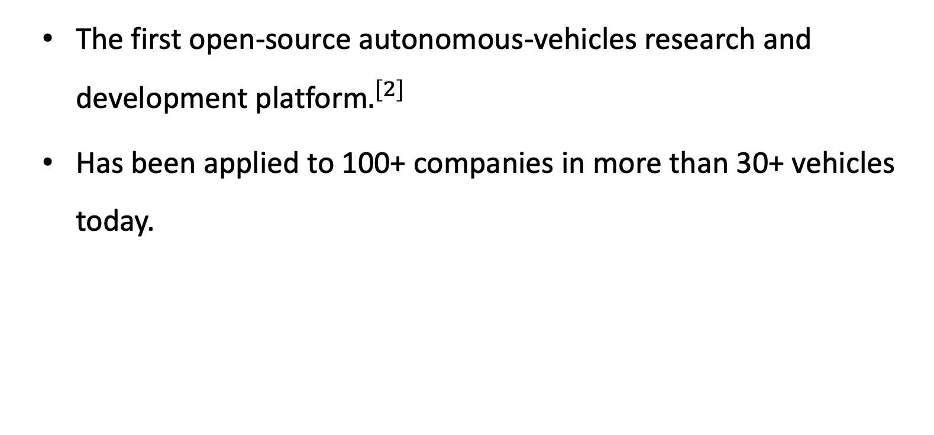
Autoware.AI
The first open-source autonomous-vehicles research and development platform$.^{[2]}$
Has been applied to 100+ companies in more than 30+ vehicles today.
3
[2]S. Kato, E. Takeuchi, Y. Ishiguro, Y. Ninomiya, K. Takeda, and T. Hamada, “An Open Approach to Autonomous Vehicles,” IEEE Micro, vol. 35, no. 6, pp. 60–68, 2015.

Slide 6
Outline
Introduction
Architectures of Self-driving cars
Problem Statement
Autoware System Models
Sensing Model
Computing Model
Actuation Model
Evaluation
Conclusion
4

Slide 7
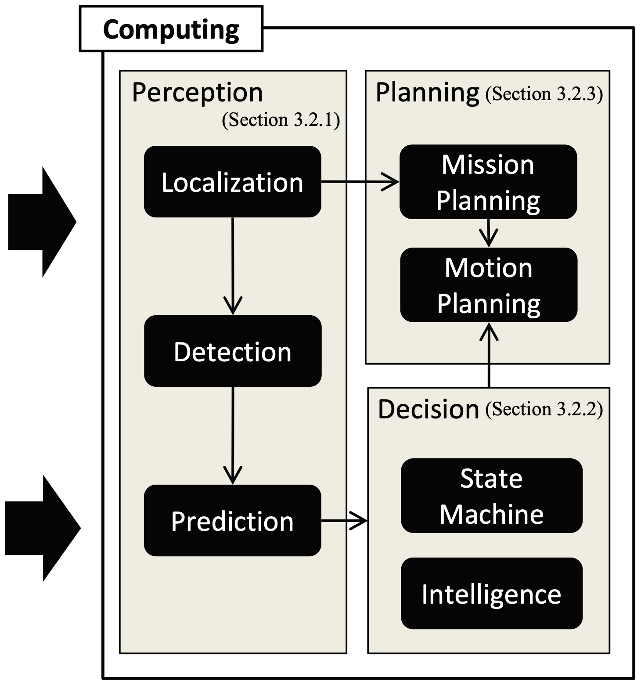
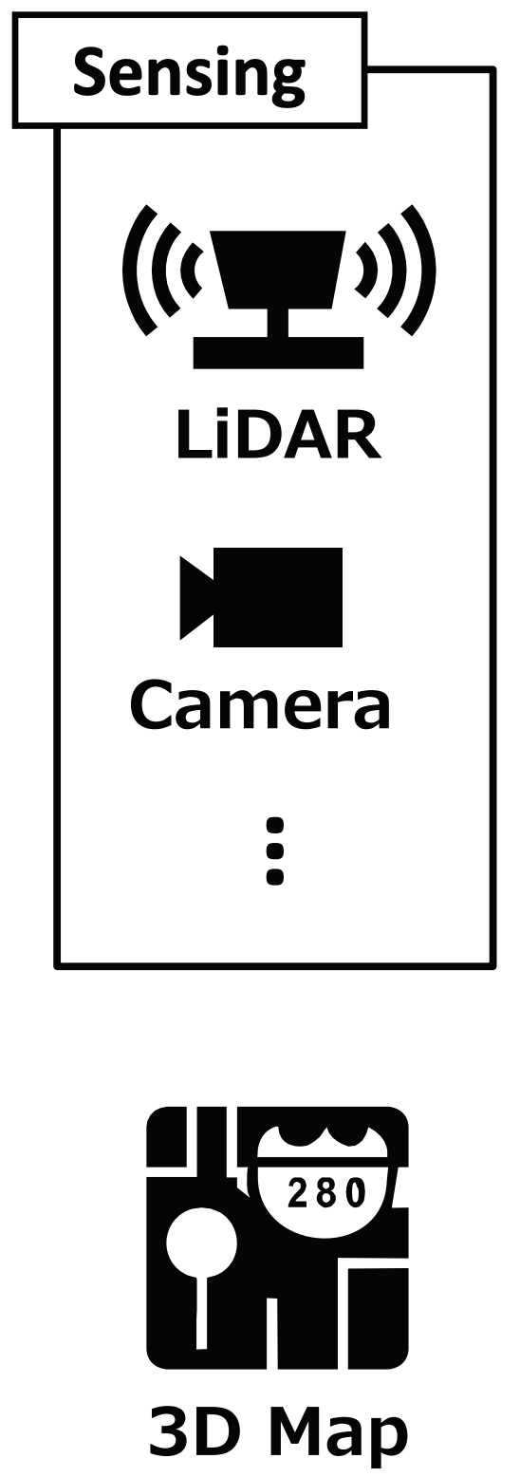
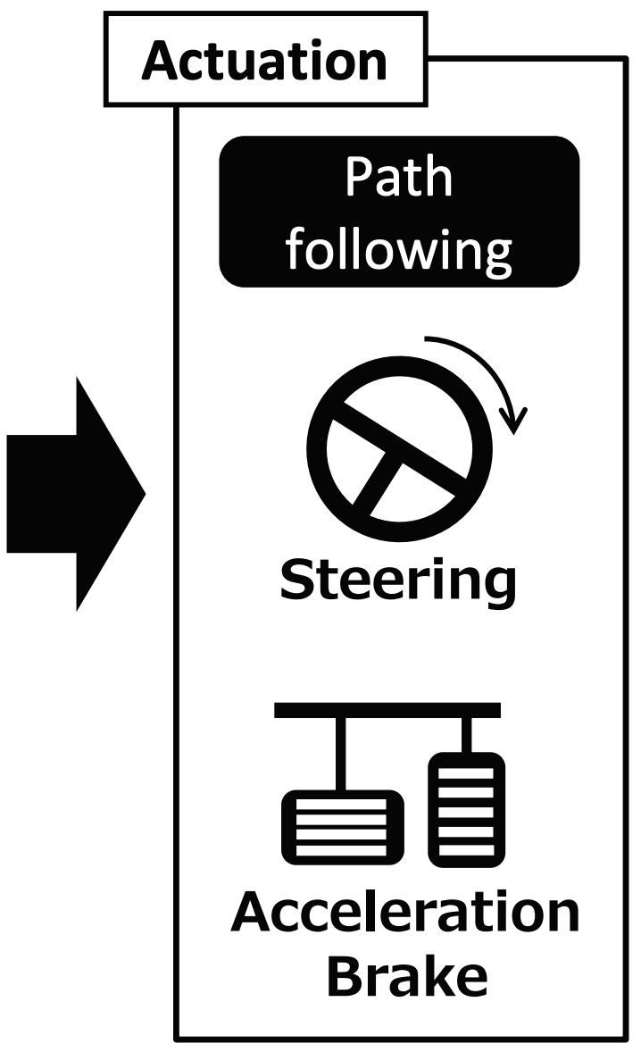
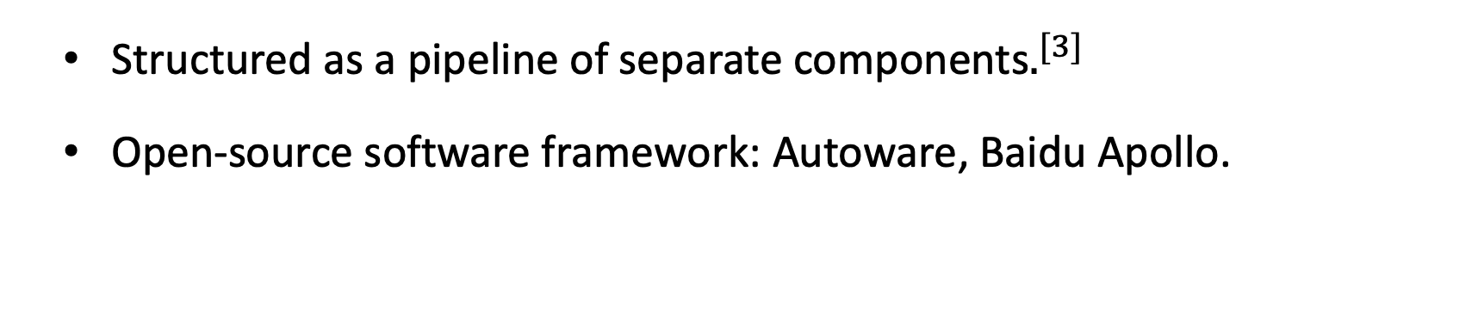
Modular Systems
Structured as a pipeline of separate components$.^{[3]}$
Open-source software framework: Autoware, Baidu Apollo.
5
[3] R. McAllister, Y. Gal, A. Kendall, M. Van Der Wilk, and A. V. Weller, “Concrete problems for autonomous vehicle safety: advantages of bayesian deep learning.” International Joint Conferences on Artificial Intelligence, Inc., 2017.

Slide 8
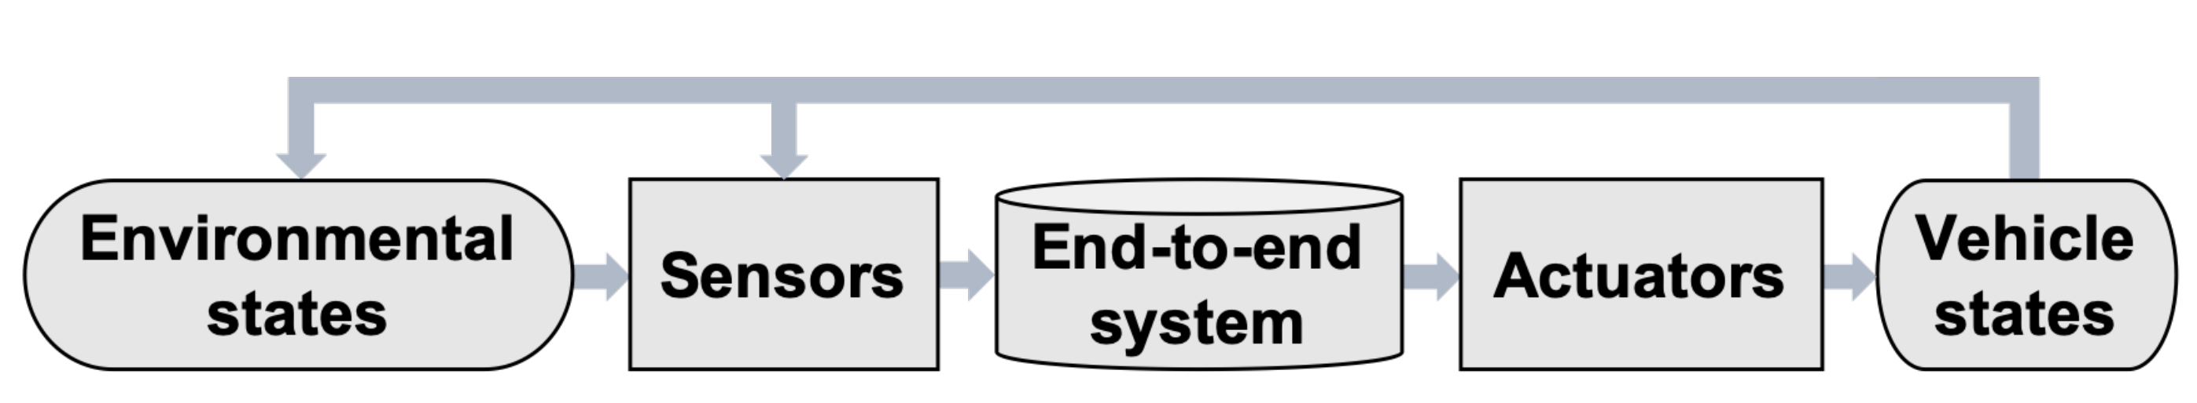
End-to-end Systems
Direct supervised deep learning
Ground truth required
Deep reinforcement learning
Deep Q Network (DQN)
Open-source simulators: AirSim, Carla
6

Slide 9
Outline
Introduction
Architectures of Self-driving cars
Problem Statement
Autoware System Models
Sensing Model
Computing Model
Actuation Model
Evaluation
Conclusion
7

Slide 10
Problem Statement
No complete open-source software framework for self-driving systems existed.
No publicly-available embedded system profile for autonomous vehicles with quantified performance evaluation.
8

Slide 11
Outline
Introduction
Architectures of Self-driving cars
Problem Statement
Autoware System Models
Sensing Model
Computing Model
Actuation Model
Evaluation
Conclusion
9

Slide 12
Autoware System Models
10

Slide 13
Outline
Introduction
Architectures of Self-driving cars
Problem Statement
Autoware System Models
Sensing Model
Computing Model
Actuation Model
Evaluation
Conclusion
11

Slide 14
Sensing Model
Cameras
Used for computer vision tasks.
LiDARs
Provide 3D representations of surrounding objects.
RaDARs
Radars emit radio waves that bounce back from objects to measure the distances.
12

Slide 15
Sensor Fusion
Each sensor has its own limitations.
Combine the advantages of each sensor to precisely understand the environment.
13

Slide 16
Outline
Introduction
Architectures of Self-driving cars
Problem Statement
Autoware System Models
Sensing Model
Computing Model
Actuation Model
Evaluation
Conclusion
14

Slide 17
Perception Module
Localization
Prior 3D Map data
Generated 3D map
Raw points
(SLAM)
Voxel grid filter
Downsample
NDT matching
Vehicle pose
Current vehicle position & direction
GNSS + IMU
Position refinement
15

Slide 18
Perception Module
Detection
Image-based 2D Object Detection
Support deep learning and traditional machine learning approaches
3D Point Cloud Detection
Prediction
Track the speed and direction of moving objects using “sensor fusion” of LiDARs and cameras.
Point Cloud data
Ground filter
Downsample
Clustering
Bounding boxes formation
16

Slide 19
Planning and Decision Making
Decision Making
Implement a finite state machine to understand, forecast, and make decisions in response to the road status.
Mission Planning
Determine the global trajectories based on the driving states.
Motion Planning
Generate local feasible trajectories.
A*, hybrid A* used under unstructured environments.
17

Slide 20
Outline
Introduction
Architectures of Self-driving cars
Problem Statement
Autoware System Models
Sensing Model
Computing Model
Actuation Model
Evaluation
Conclusion
18

Slide 21
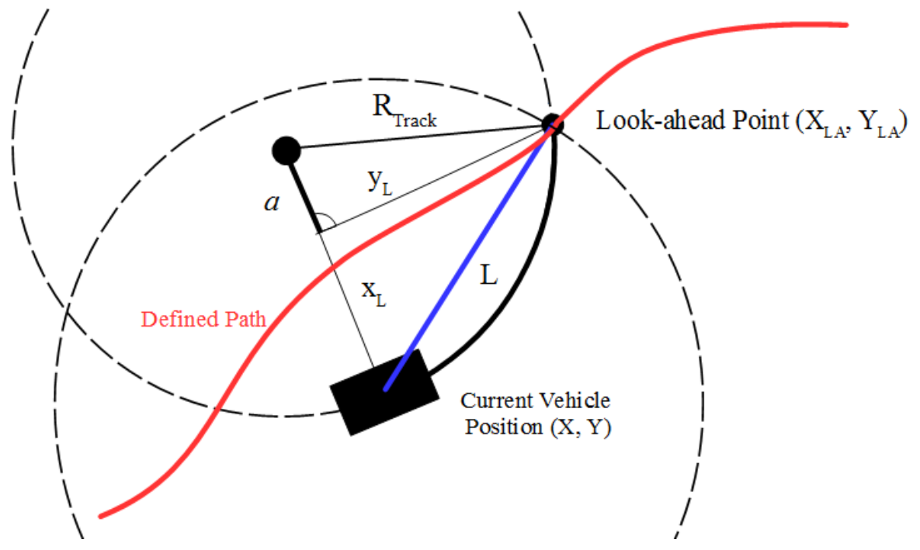

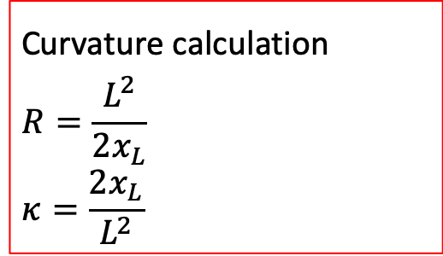
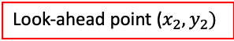
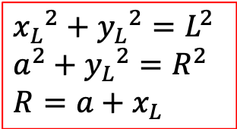
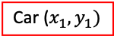



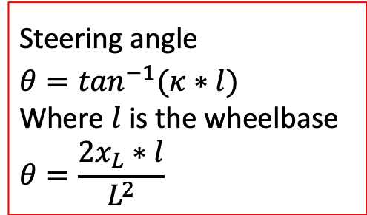
Actuation Model
Path Following
Use pure pursuit algorithm to generate the actuation commands
$${x_{L}}^{2}+{y_{L}}^{2}=L^{2}$$
$a^{2}+$ ${y_{L}}^{2}=R^{2}$
$R=a+$ $x_{L}$
Look-ahead point ($x_{2}, y_{2})$
Steering angle
$$θ=\tan^{−1}(κ∗l)$$
Where $l$ is the wheelbase
$$θ=\frac{2x_{L}∗l}{L^{2}}$$
R
$$y_{L}$$
a
Steering angle offset
Curvature calculation
$$R=\frac{L^{2}}{2x_{L}}$$
$$κ=\frac{2x_{L}}{L^{2}}$$
$$L$$
$$θ$$
$$x_{L}$$
Desired path
Car ($x_{1}, y_{1})$
19

Slide 22
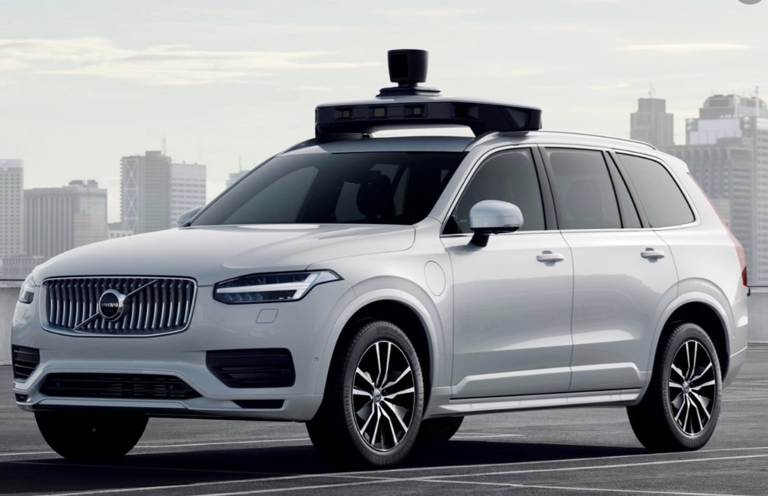
Actuation Model
Vehicle Control
PID controller applied to actuate the steering and throttle.
Ensure a minimum distance between vehicle and obstacles.
Throttle
Desired speed & angle
PID controller
Speed & Angle
+
Steering
-
20

Slide 23
Outline
Introduction
Architectures of Self-driving cars
Problem Statement
Autoware System Models
Sensing Model
Computing Model
Actuation Model
Evaluation
Conclusion
21

Slide 24
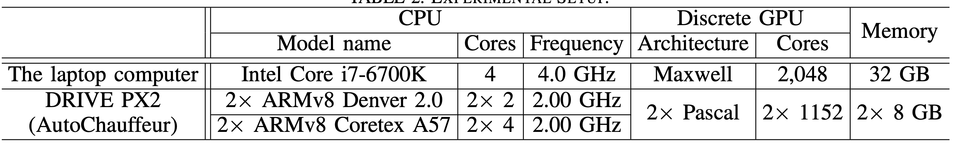
Experimental Setup
Devices Configurations
Autoware v1.5.1
22

Slide 25
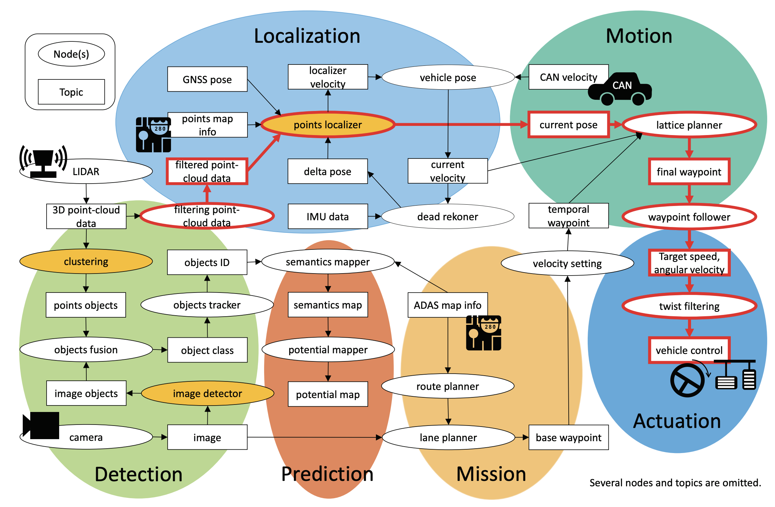
Measurements
Tested Packages:
Clustering
Image detector
Point localizer
End to end time
23

Slide 26
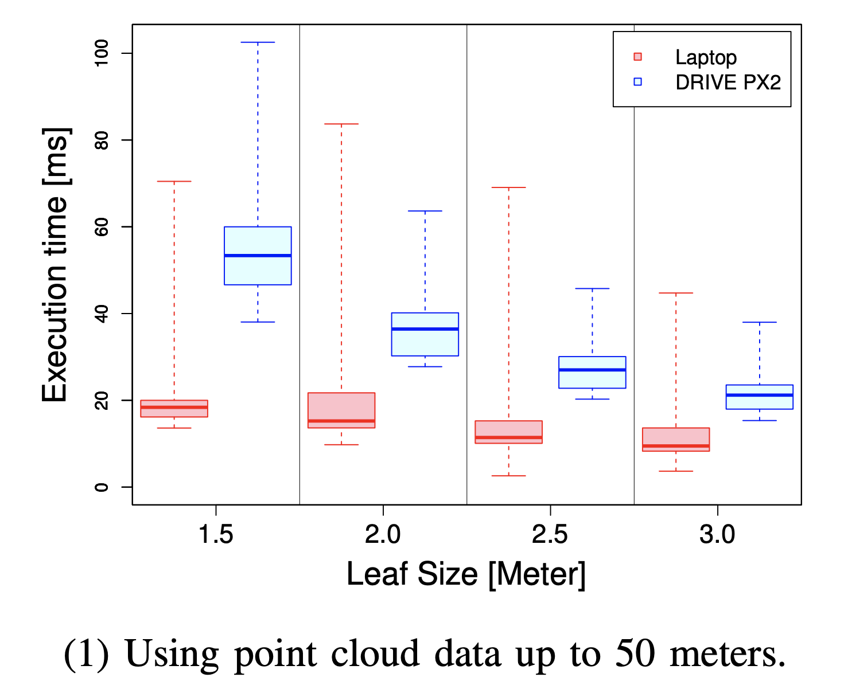
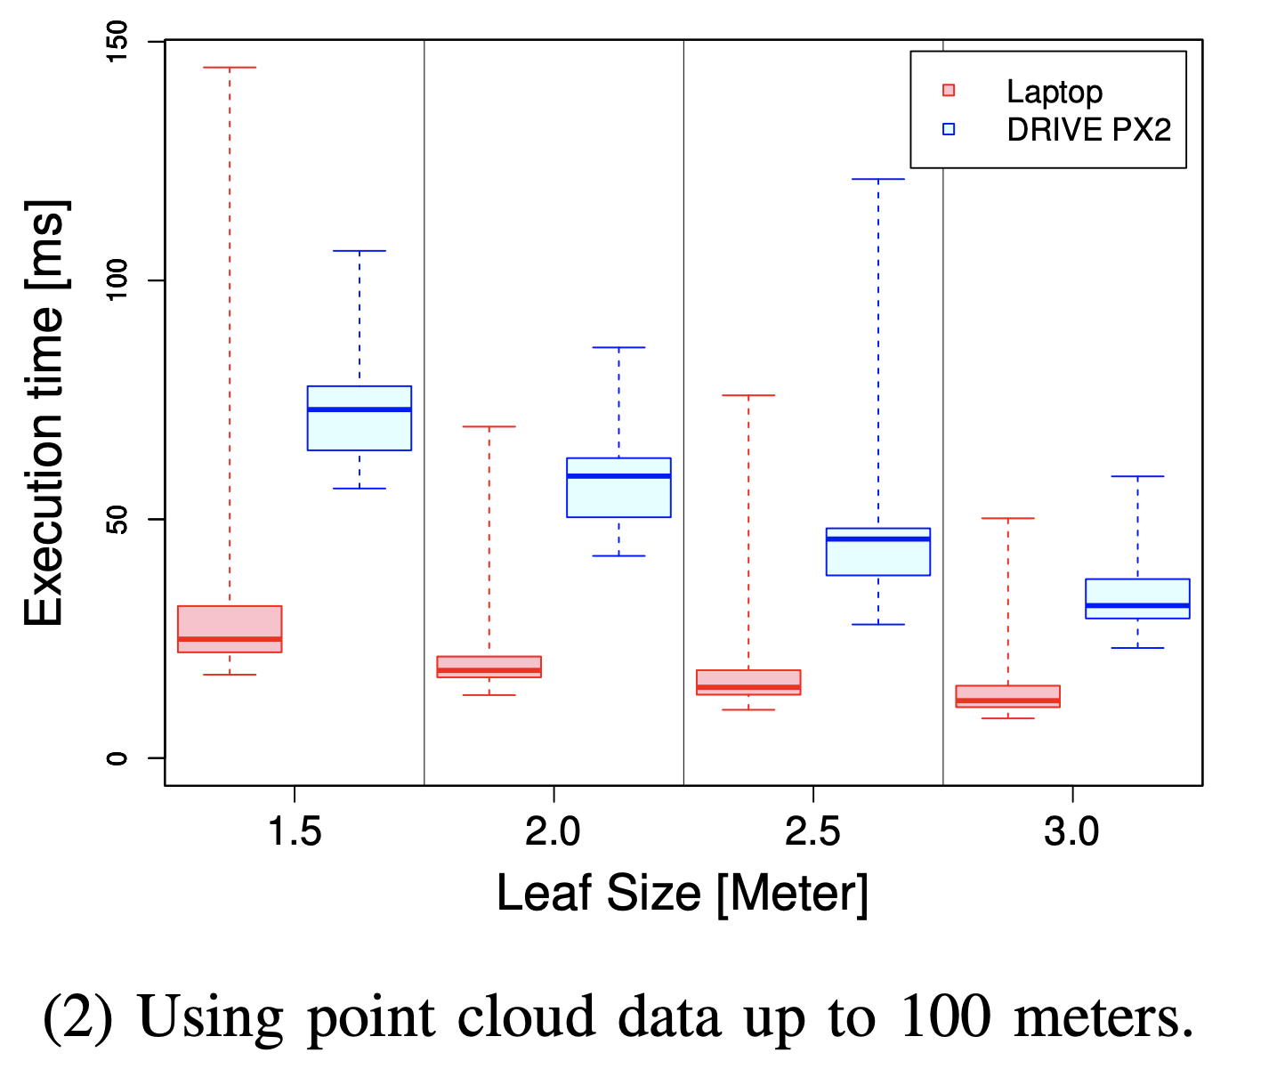
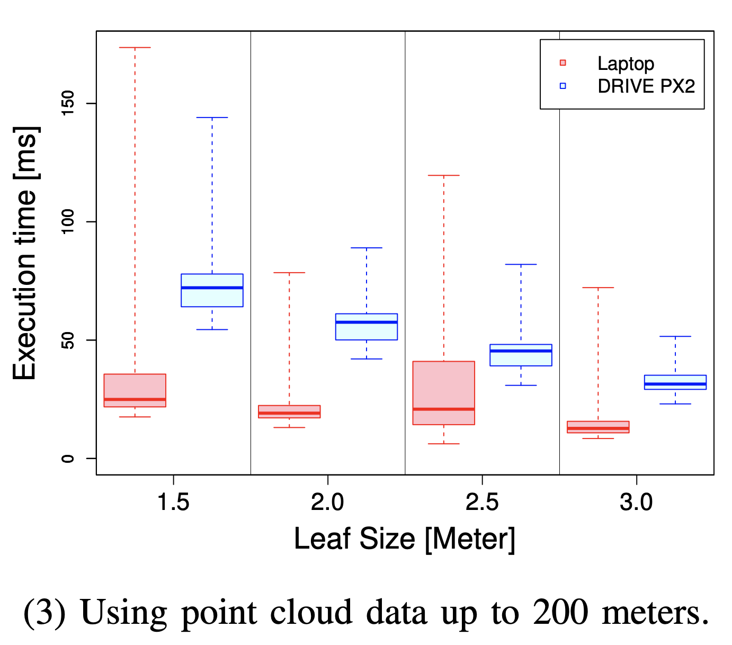
Evaluation of Point Localizer
Points localizer calculates the position and orientation of the vehicle.
Larger leaf sizes reduce the execution time.
Shorter data ranges reduce the execution time.
24

Slide 27
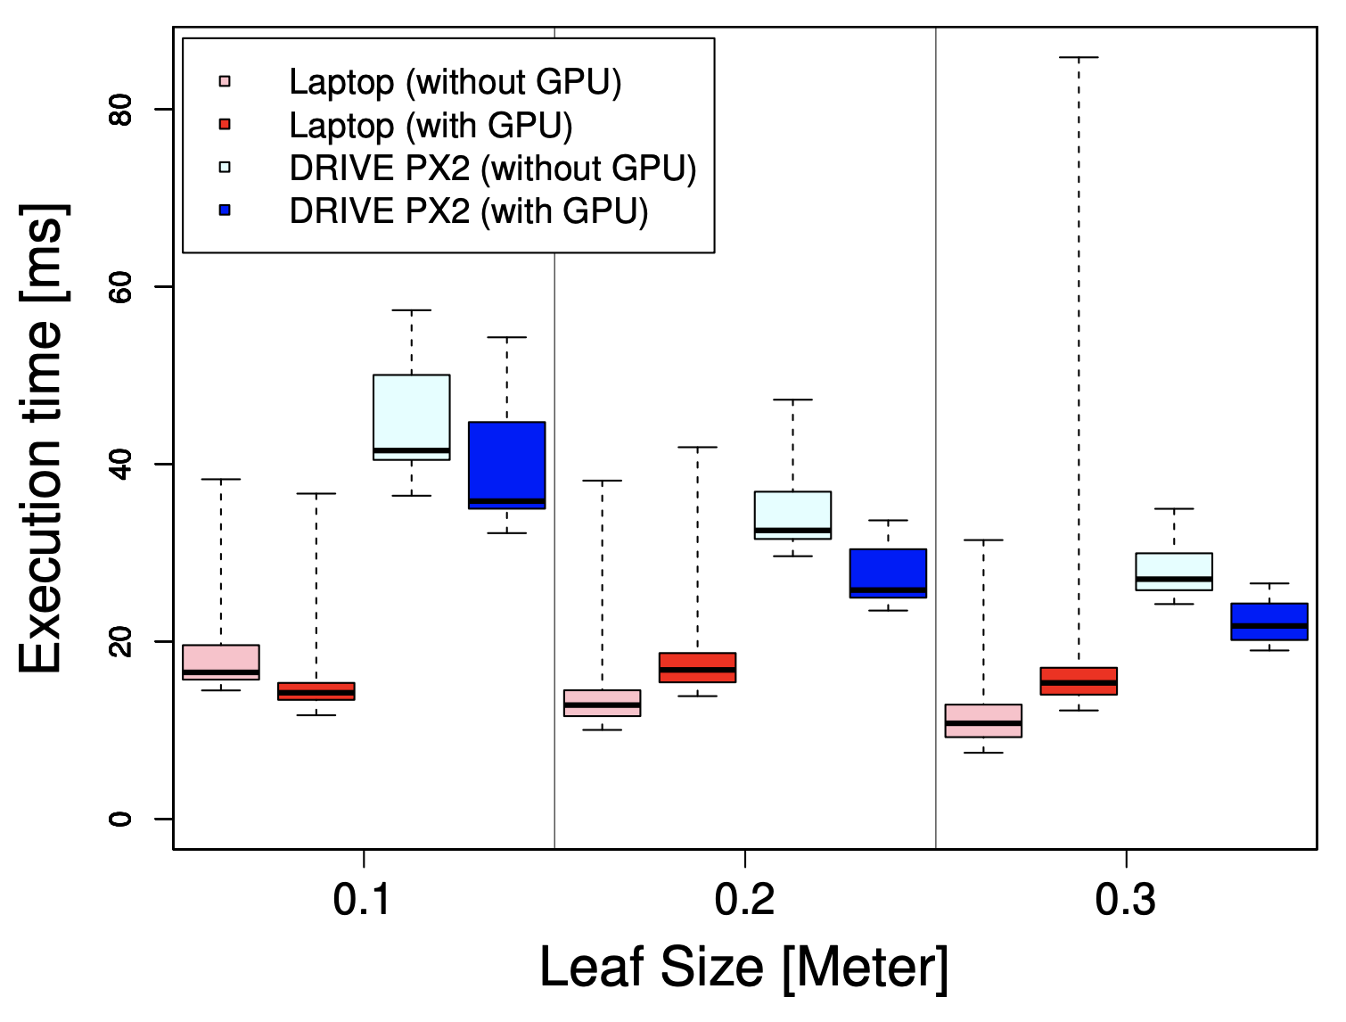
Evaluation of Clustering
Clustering package segments each object using point cloud data.
Execution time decreased as the leaf size increased.
For DRIVE PX2, presence of GPU helps decrease execution time.
Not the case for laptop.
25

Slide 28
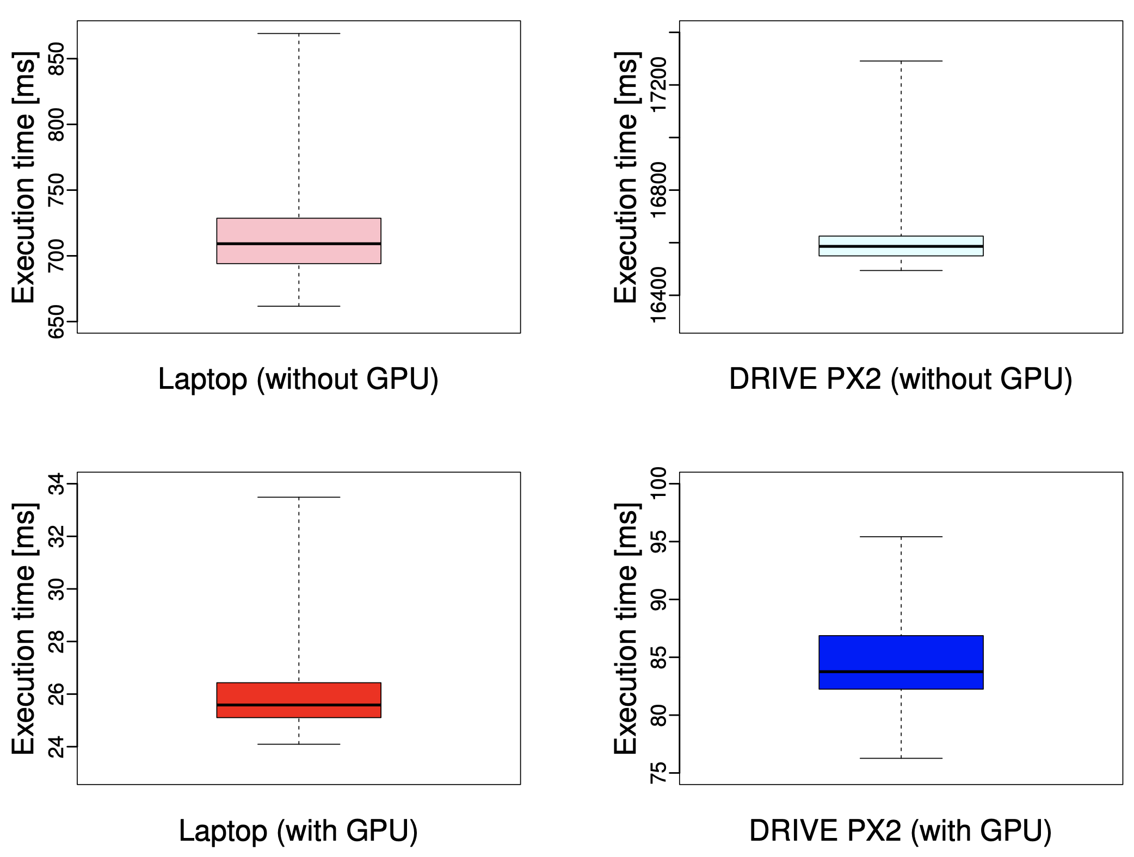
Evaluation of Image Detector
Image detector uses 2D image features to recognize the objects.
GPU is truly useful to image detection
Performance difference due to different core number on two platforms.
26

Slide 29
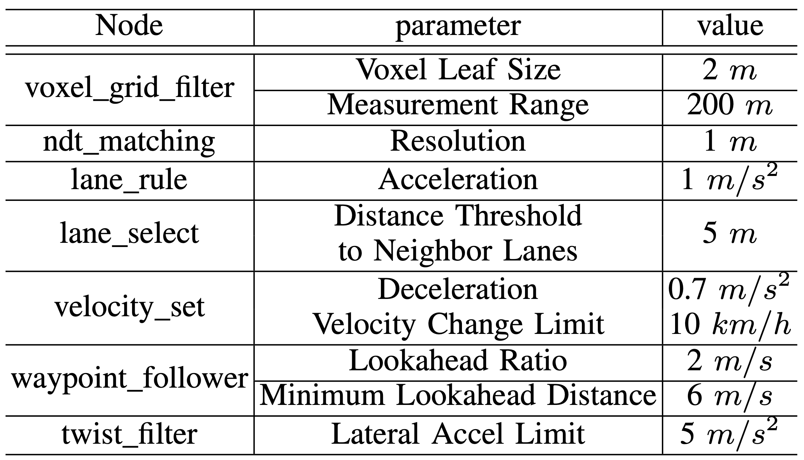
End-to-end Workflow
Configuration of these end-to-end nodes
27

Slide 30
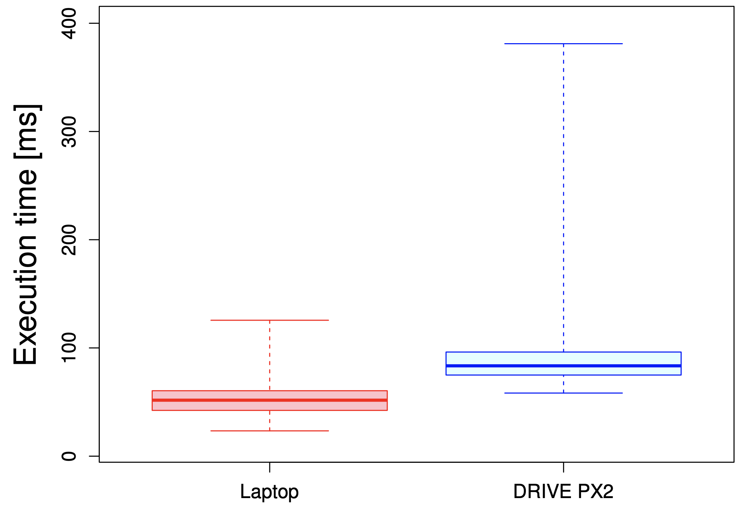
End-to-end Time
The worst execution time of DRIVE PX2 is three times as much as that on laptop.
DRIVE PX2 platform provides the acceptable level of performance for Autoware installed to real autonomous vehicles.
28

Slide 31
Outline
Introduction
Architectures of Self-driving cars
Problem Statement
Autoware System Models
Sensing Model
Computing Model
Actuation Model
Evaluation
Conclusion
29

Slide 32
Conclusion
Strengths
Democratize the research of autonomous vehicles.
Provide a detailed explanation of the workflow of self-driving vehicles.
Out-of-box and easy to integrate.
Weaknesses
Does not clarify the process of building Autoware on DRIVE PX2.
Evaluation is not enough without evaluating the accuracy of each tested package.
DRIVE PX2 is not suitable for SAE level 4 or 5 vehicle autonomy.
30

Slide 33
Thank You!

Slide 34
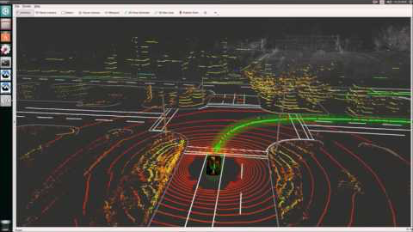
Demonstration Movie
28

Slide 35
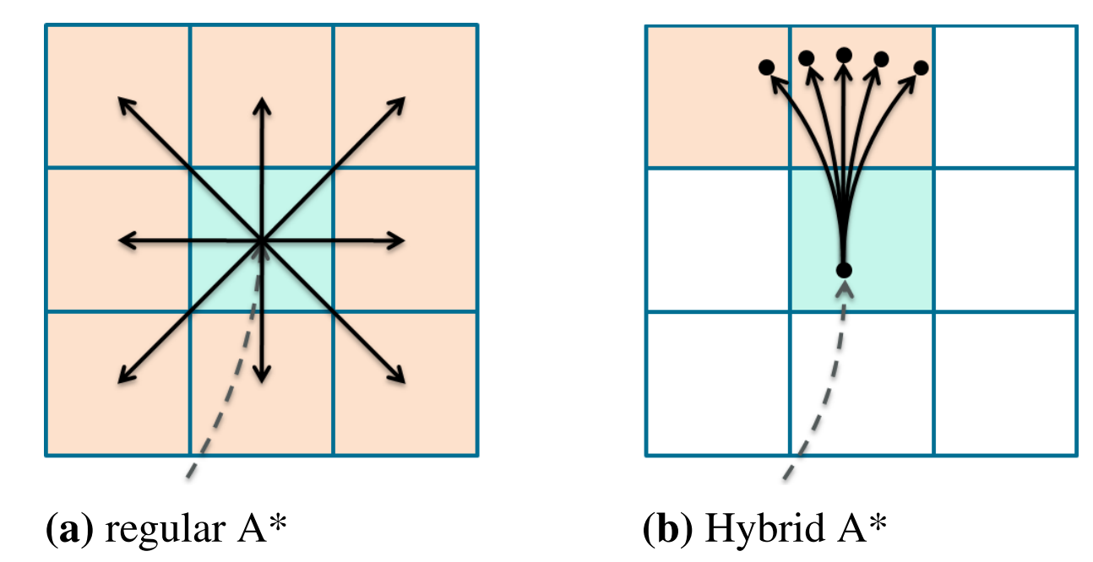
A* Algorithm
Priority Queue ordering is based on:
g(n): the distance (cost) from start vertex to vertex n.
h(n): the heuristic estimated cost from vertex n to goal vertex
f(n) = g(n) + h(n)
Animation of A* algorithm
Hybrid A* algorithm

Slide 36
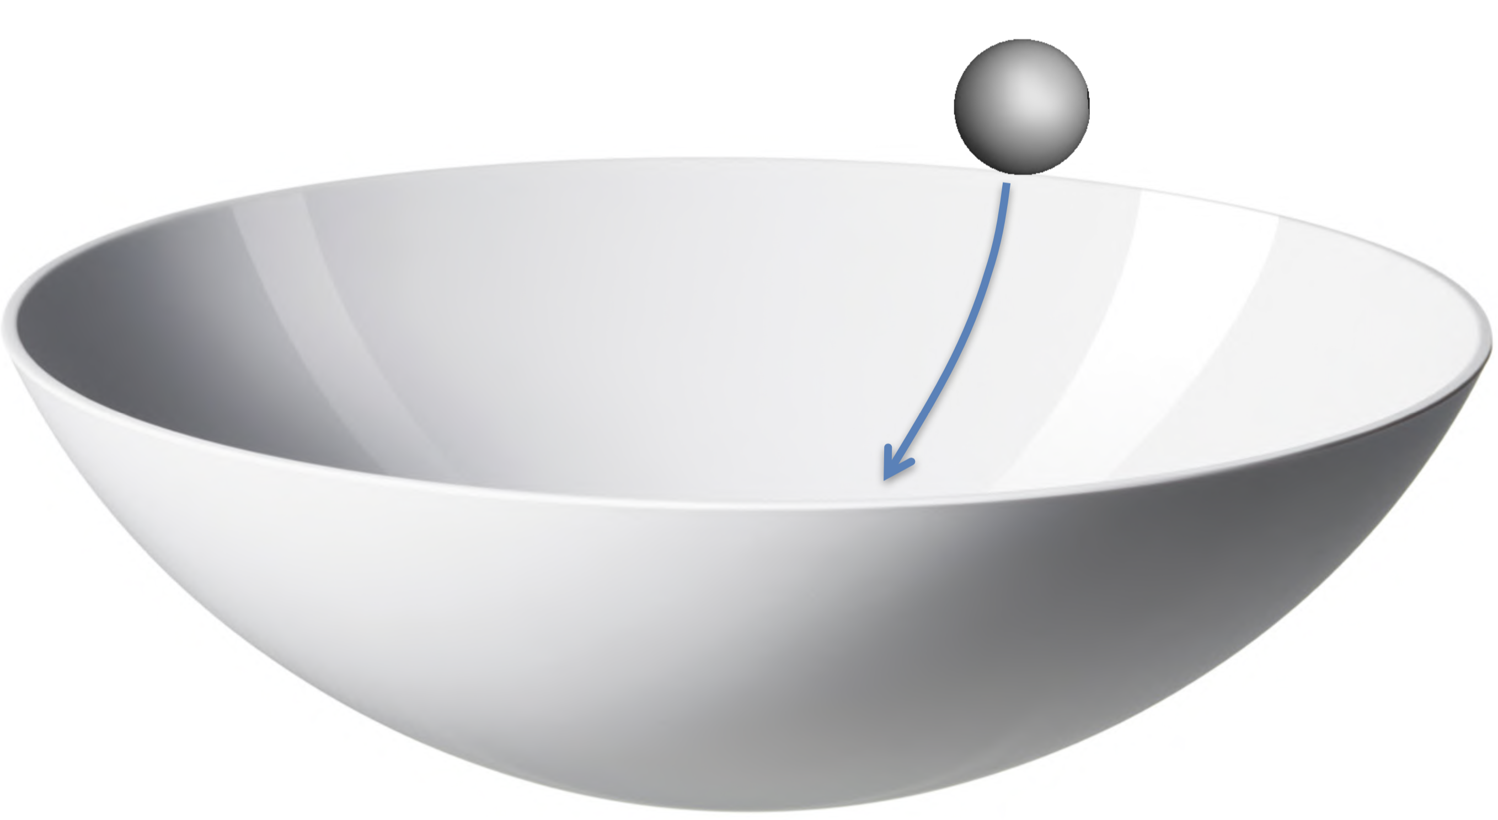
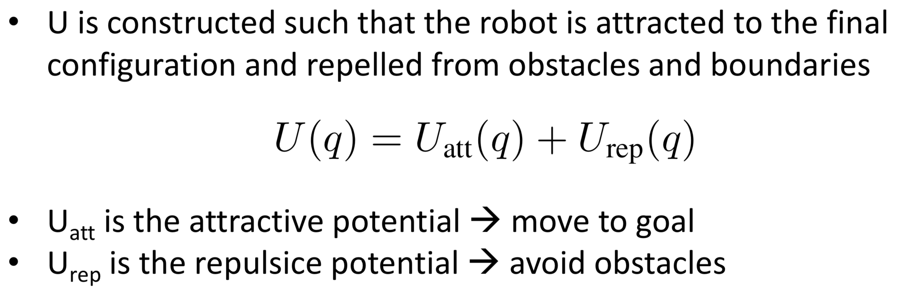
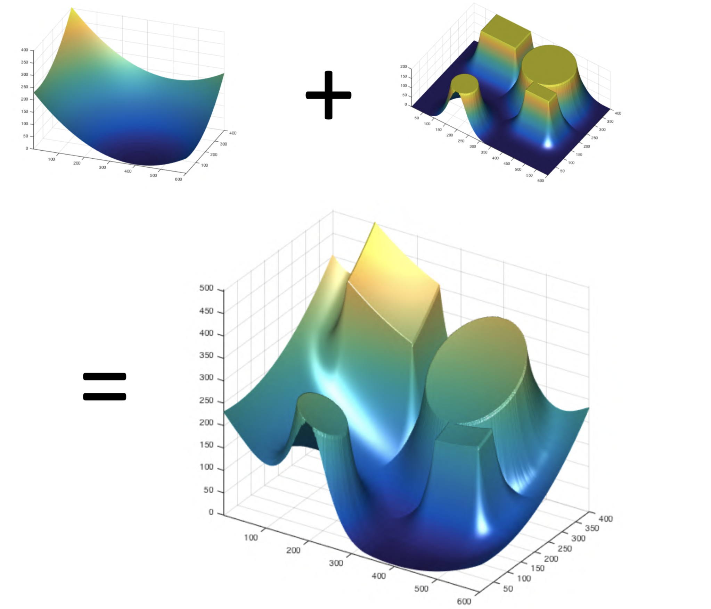
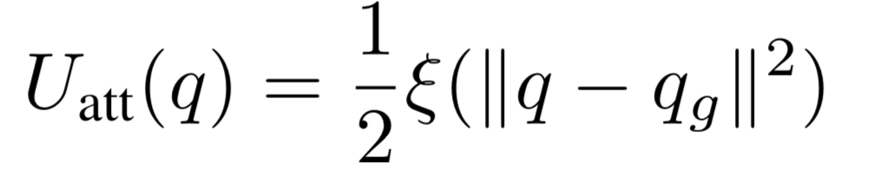
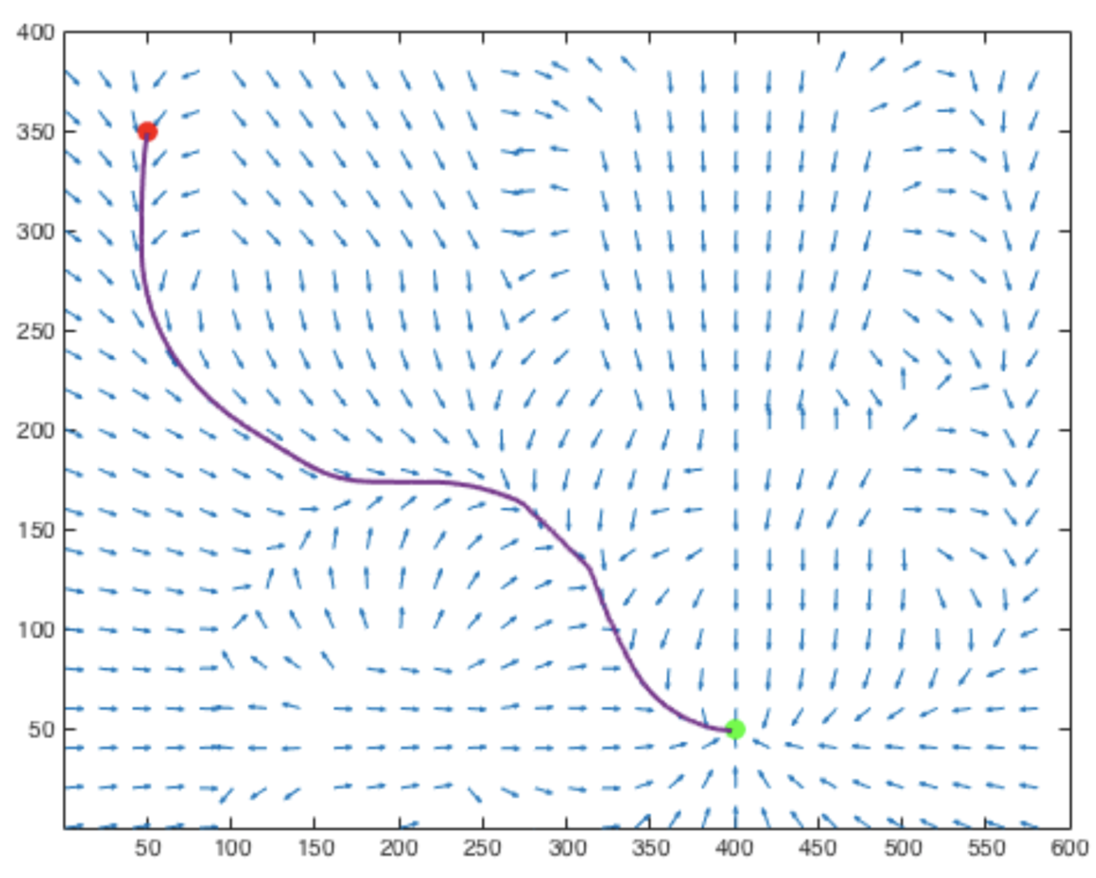
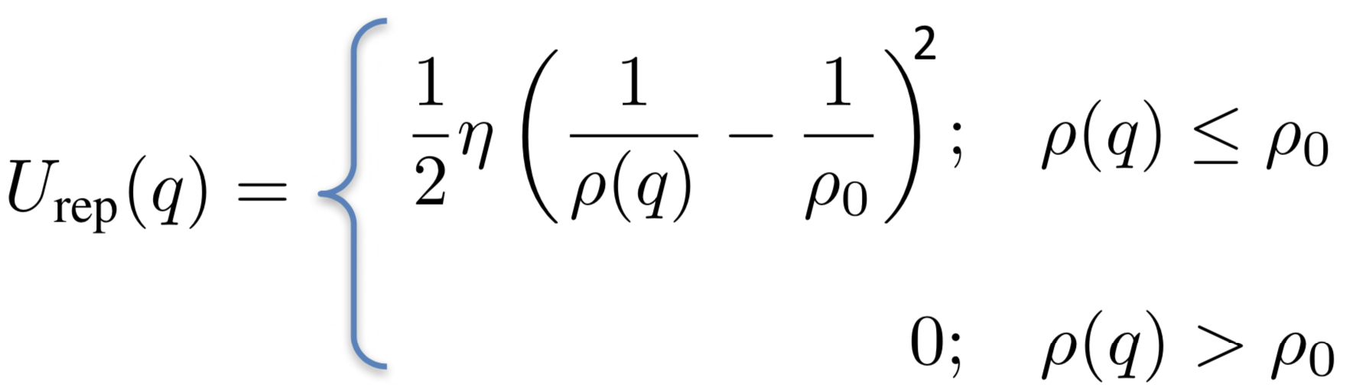
Potential Field
Notes:
BOWL store the potential energy, robot moves to a lower energy configuration
Energy is minimized by following the negative gradient of the potential energy function

Slide 37
